Slide 1
Introduction to psychology
Zainab khan Ph.D (fellow)

Slide 2

WHAT IS PSYCHOLOGY?
Introduction to Psychology
There are many ways that we could answer this question.
However, try to decide for yourself what you understand psychology to be.
What do you think the man in the street understands when he/she hears the word ‘psychology’?
Can you make some suggestions?

Slide 3

WHAT IS PSYCHOLOGY?
TRUE
FALSE
Psychology is a science.
Psychology is about psychiatrists.
Psychology is about understanding people.
Psychology explains everything.
Psychologists look at one aspect of behaviour.
It’s a scientific study.
Psychology is about people’s minds.
Psychology is about animals only.
Culture explains psychology.
Mental processes are important to psychology.

Slide 4
WHAT IS PSYCHOLOGY?
TRUE
TRUE
Psychology is a science.
The word ‘psychology’ comes from the Greek word ‘psyche’ which means the soul or mind.
Psychology is about understanding people.
The second part of the word indicates knowledge or study.
It’s a scientific study.
Psychology is about people’s minds.
If you take the two together, it implies the science of the mind.
Psychologists carry out research into people’s experience and behaviour, just like a scientist would do.
Culture explains psychology.
Mental processes are important to psychology.

Slide 5
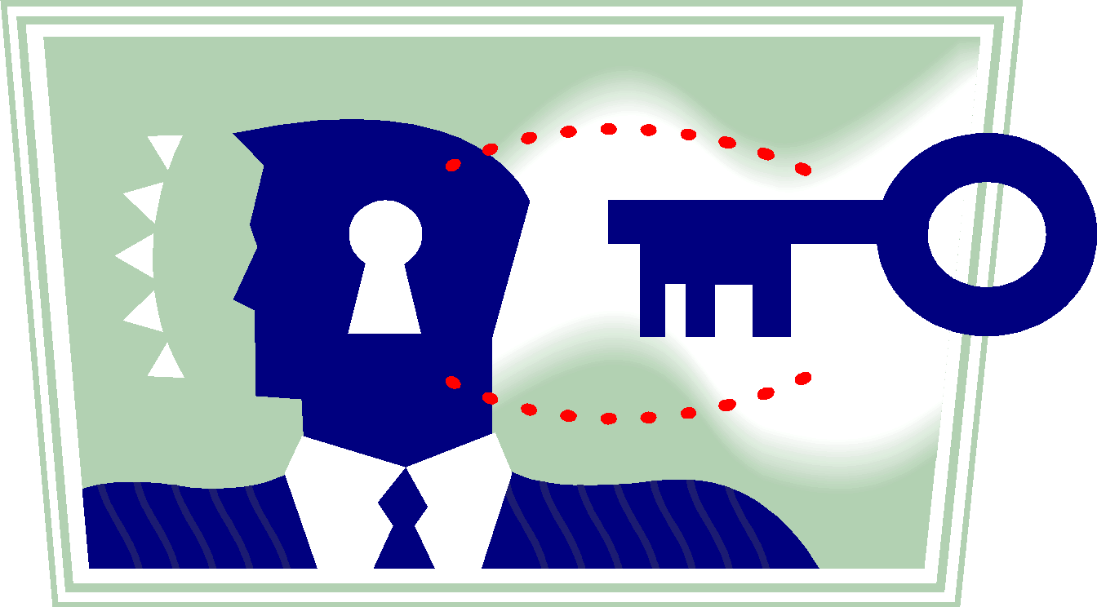
WHAT IS PSYCHOLOGY?
TRUE
TRUE
Psychologists have a difficult task of understanding people. After all, you cannot get inside someone’s mind.
Psychology is a science.
Psychology is about understanding people.
You can observe their behaviour though and draw conclusions from those observations.
It’s a scientific study.
Psychology is about people’s minds.
Psychologists are interested in understanding the mind and behaviour of people.
Culture explains psychology.
Psychology tries to understand the way in which human beings and sometimes animals behave and experience the world.
Mental processes are important to psychology.

Slide 6

WHAT IS PSYCHOLOGY?
TRUE
TRUE
Psychology is a science.
Psychology has been described as a science.
Psychology is about understanding people.
Psychologists have to undertake research to make their conclusions.
It’s a scientific study.
Psychologists take the individual and his/her experiences and behaviour as the focal point for research and data.
Psychology is about people’s minds.
Culture explains psychology.
Psychologists, like pure scientists, have to conduct experiments and collect evidence to make conclusions.
Mental processes are important to psychology.

Slide 7


WHAT IS PSYCHOLOGY?
TRUE
TRUE
Psychology is a science.
Our interaction with other people interests psychologists.
Psychology is about understanding people.
Different cultures can make assumptions about people.
It’s a scientific study.
Psychology is about people’s minds.
Being part of a particular culture has a profound effect on people.
Culture explains psychology.
We all live within social groups and they influence our thoughts and behaviour.
Mental processes are important to psychology.

Slide 8
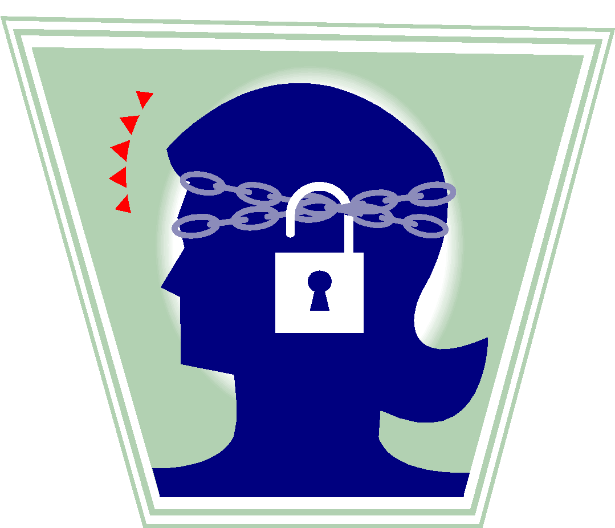
WHAT IS PSYCHOLOGY?
TRUE
TRUE
Psychology is a science.
Consciousness is a part of human experience.
Psychology is about understanding people.
Mental processes explain why we behave and act as we do.
It’s a scientific study.
Psychology is about people’s minds.
When studying humans or animals, psychologists record their observations to understand and predict mental processes.
Culture explains psychology.
Mental processes are important to psychology.

Slide 9
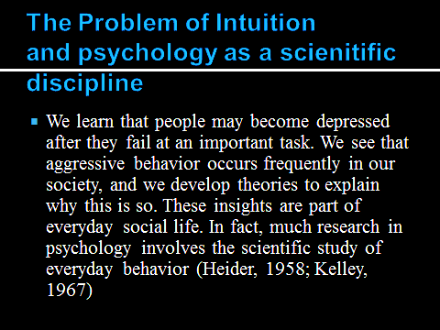

Slide 10
¡ For example, eyewitnesses to violent crimes are often extremely confident in their identifications of the perpetrators of these crimes. But research finds that eyewitnesses are no less confident in their identifications when they are incorrect than when they are correct (Cutler & Wells, 2009; Wells & Hasel, 2008).

Slide 11
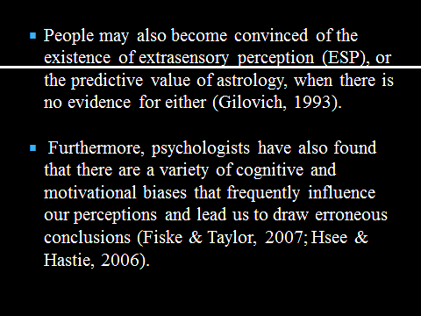

Slide 12
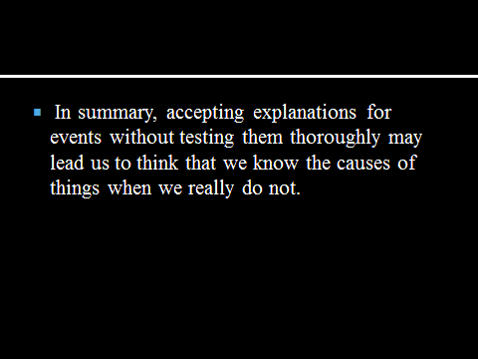

Slide 13
USE OF PSYCHOLOGY IN DAILY LIFE
Watch this video first
https://youtu.be/U4PezqUovLw
To leverage psychological science to live better we need to CHILL, DRILL, and BUILD:
CHILL (Take time out from an emotional event to let your biology return to normal).
DRILL (Practice specific productive ways of thinking to modify automatic thoughts that are unproductive).
BUILD (your social networks).
Regan A. R. Gurung, PhD June 11, 2018

Slide 14
MAJOR SUB FIELDS OF PSYCHOLOGY
Biological Psychology
Experimental Psychology
Social & Personality Psychology
Clinical & Counseling Psychology
School & educational Psychology
Organizational/Industrial Psychology
Developmental Psychology
Sports Psychology
Health Psychology
Forensic Psychology

Slide 15


WHAT IS PSYCHOLOGY?
Clinical Psychology
This involves helping people who have mental health concerns or problems. The aim is to help people cope more successfully with their lives.

Slide 16

WHAT IS PSYCHOLOGY?
Occupational Psychology
This involves improving people’s performance in the work place, by reducing stress factors, for example, or by making sure that the best candidate is chosen for a specific job.

Slide 17

WHAT IS PSYCHOLOGY?
Consumer Psychology
This involves working with businesses and within industry to promote an understanding of how and why consumers behave and choose products. Marketing and advertising are areas that use this type of psychology.

Slide 18

WHAT IS PSYCHOLOGY?
Sports Psychology
This involves enhancing and improving personal sports performance. The psychologist works with sportsmen and women, teams, coaches and sports clubs. He /she devises better training programmes to improve competitive performance.

Slide 19

WHAT IS PSYCHOLOGY?
Counselling Psychology
This involves dealing with people who have personal problems or problems in relationships. The aim is to help people deal with the stresses of their everyday life.

Slide 20

WHAT IS PSYCHOLOGY?
Educational Psychology
This involves working with school aged children and young adults. Educational support is offered to pupils, parents and teachers.

Slide 21

WHAT IS PSYCHOLOGY?
Research Psychology
This involves undertaking research both academically and in other areas such as in industry, for example.

Slide 22

WHAT IS PSYCHOLOGY?
Forensic Psychology
This involves working with criminals in an effort to understand and/or change their behaviour. It usually involves working closely with the police and prison staff. It can cover the rehabilitation of criminals as well as finding the perpetrators of an individual crime.

